Slide 1
Big Data Analytics course CSDA1000SUMA18 Group 1, Final Project
Airport Gate Assignment Optimization Presentation
Viviane Adohouannon
Kate Alexander
Juan Arangote
Diana Azbel
Igor Baranov
York University School of Continuous Studies

Slide 2
Introduction, Business goal - Juan

Slide 3
Data overview, insight's - Viviane

Slide 4

Airlines performance analysis – Diana & Kate
Dataset: 2015 Flight Delays and Cancellations
From: United States of America, Department of Transportation
URL: https://www.kaggle.com/usdot/flight-delays/data
airlines.csv
airports.csv
flights.csv
Dataset: Aircraft Registry
From: United States of America, Federal Aviation Registry
URL: https://www.faa.gov/licenses_certificates/aircraft_certification/aircraft_registry/
MASTER.txt
ACFTREF.txt
Research focus: San Francisco International Airport (SFO)

Slide 5
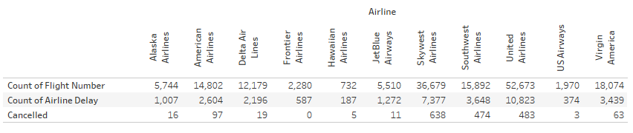
Airlines performance analysis
Baseline:
Total count of Airline Delay: 33,514
Total number of Cancelled flights: 1,809
Total number of flights: 166,535
Estimated number of Passengers: 366,043,930

Slide 6
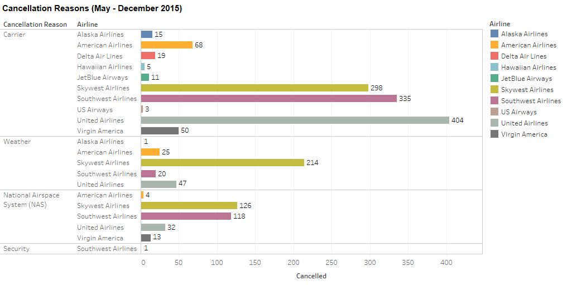
Airlines performance analysis
Sum of Cancellation Reasons vs. Airline – May through December 2015
Sum of Cancelled for each Airline broken down by Airport Origin vs. Cancellation Reason.
Colour shows details about the Airline.
This view is filtered on Cancellation Reason.

Slide 7
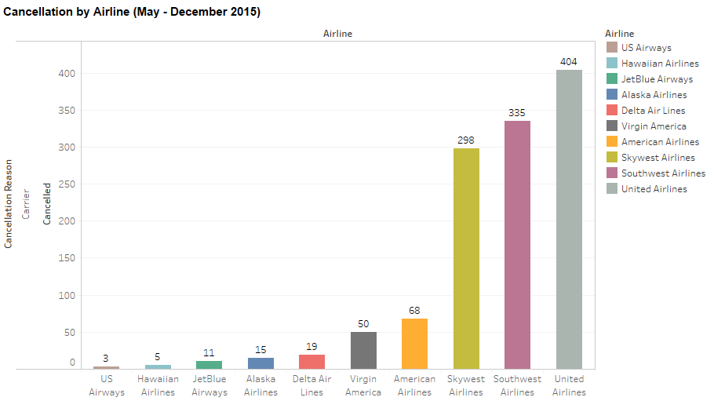
Airlines performance analysis
Sum of all cancellations by Airlines: 1,208 flights (May through December 2015)

Slide 8
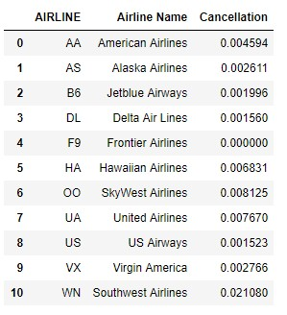
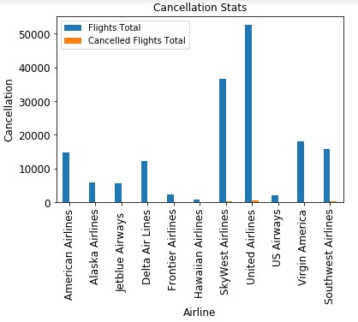
Percentage of cancellation per Airline

Slide 9
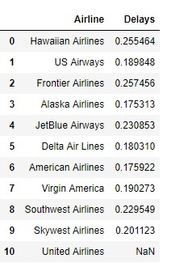
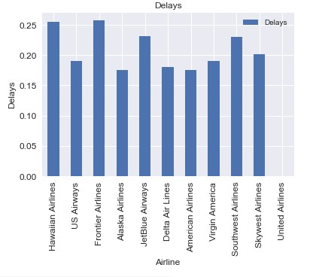
Airlines performance analysis
Percentage of delay per Airline

Slide 10
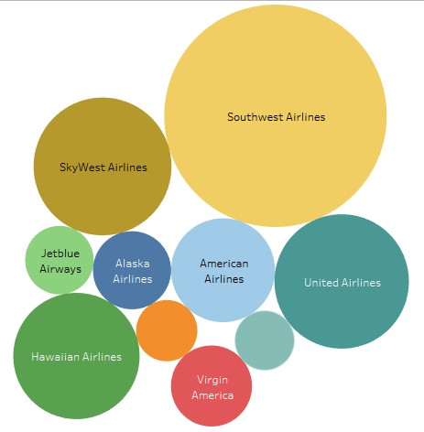
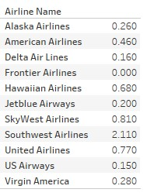
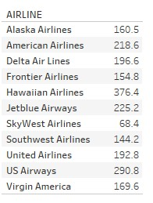
Airlines performance analysis
The estimated number of passengers per Airline
Estimate number of passengers affected by Cancellations per Airline

Slide 11
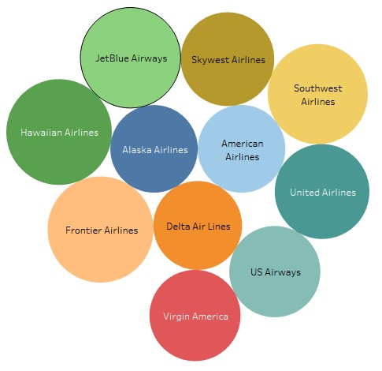
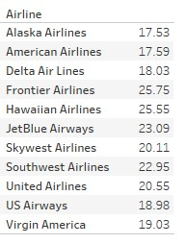
Airlines performance analysis
Estimate number of passengers affected by delay per Airline

Slide 12
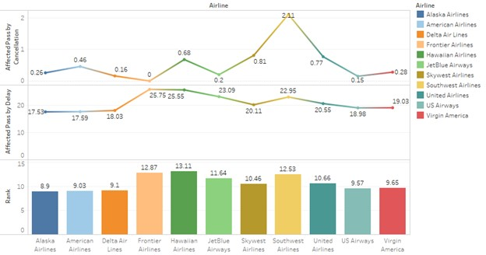
Airlines performance analysis
Results: Performance of the Airlines:

Slide 13
Airlines performance analysis
Historical data and linear progressing, the estimated future delays and cancellations in the next 5, 10, 20 years by airline
For the best airline only

Slide 14
Airlines performance analysis
the estimated ﬁnancial costs, of delays and cancellation –Igor (from the model?)

Slide 15
Competitive analysis - Igor

Slide 16
Model - Igor

Slide 17
Conclusion - Igor

